Slide 1
CBI NI Digital Forum
14th December 2018
Dr Owen Sims
Senior Policy Advisor, CBI

Slide 2
NI Digital Economy: Taking Stock, Looking Ahead
Dr Owen Sims
Senior Policy Advisor, CBI

Slide 3
Background: The CBI NI Digital Forum
The CBI NI Digital Forum has been established to:
  Develop policy for Northern Ireland’s Digital Economy;
  Inform organizations of developments within the economic environment for digital skills & investment; and
  Convening companies with policy-makers and government officials.
Output will take the form of policy recommendations to help construct a Digital Strategy, but will be mainly shaped by members. Intends to meet quarterly.
Meetings are an opportunity to:
  Discuss the digital economic environment within the Northern Irish economy.
  Discuss your Digital ‘State of Trade’ (e.g. projects, adoption challenges).
  Engage with senior members of Invest NI on international investment and skills strategy.

Slide 4
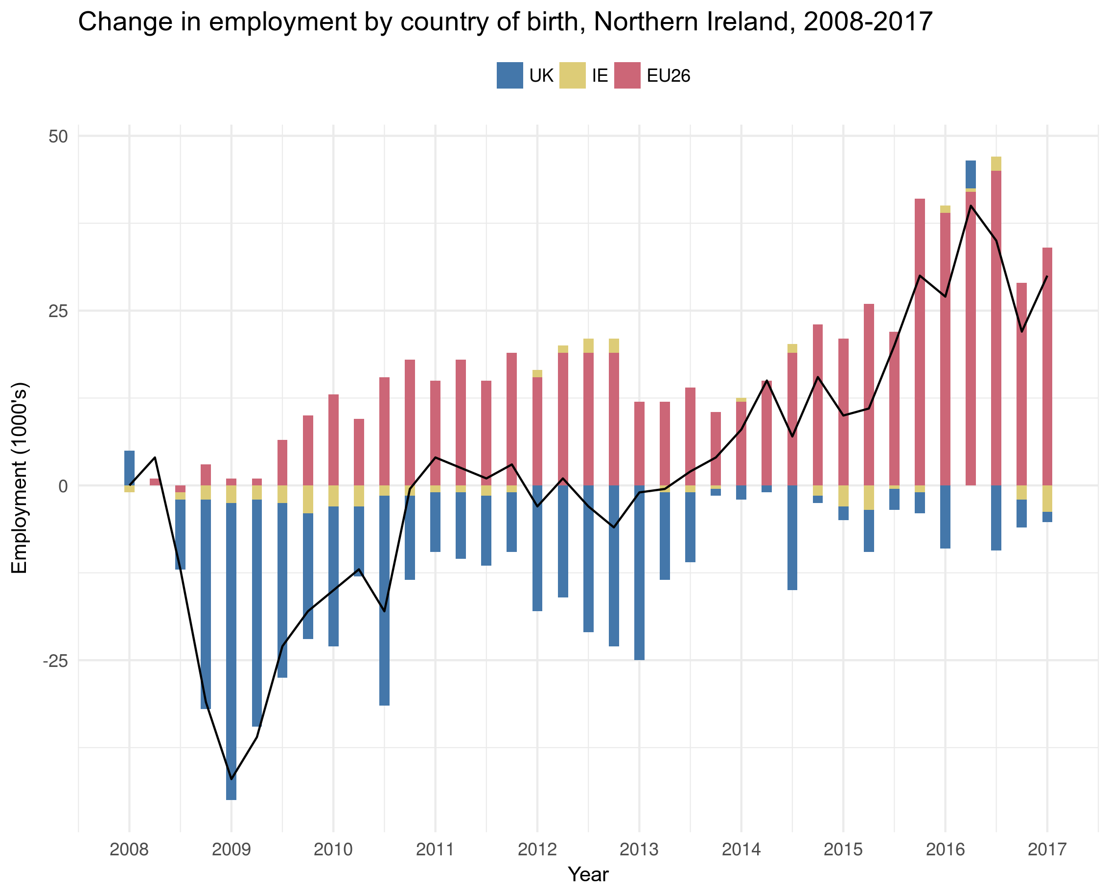
Contribution to employment
The global financial crisis (2008/2009) brought with it a structural change to the make-up of the NI labour market.
Over the past decade migrant workers from EU economies have driven employment in NI beyond the pre-crisis levels.
Increasingly filling skills gaps through all levels of occupational complexity.
In total, NI has welcomed 36,000 migrants to work and settle in its borders over the past 10 years.

Slide 5
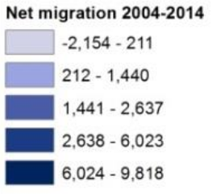
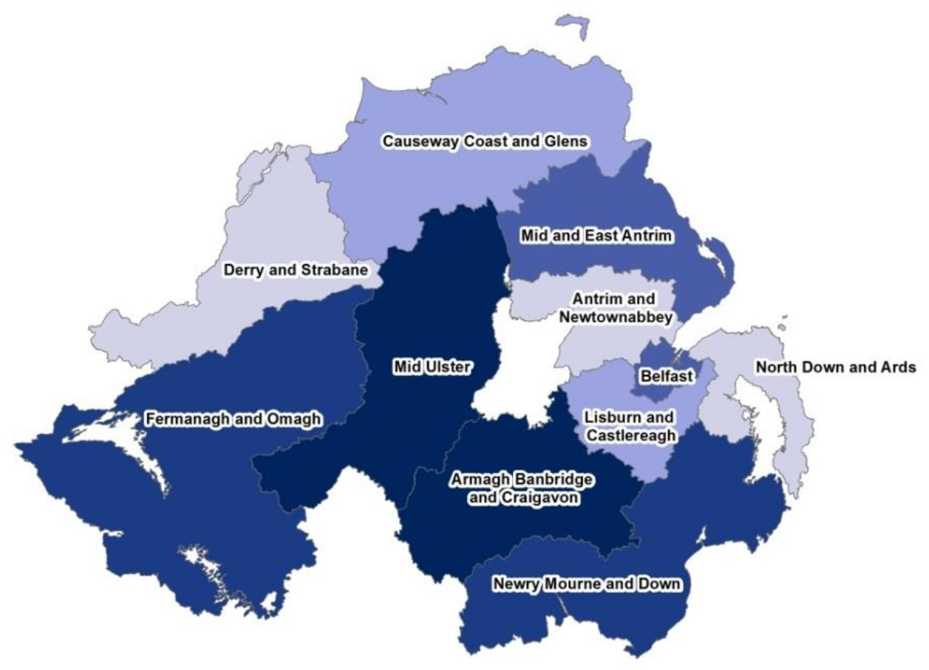
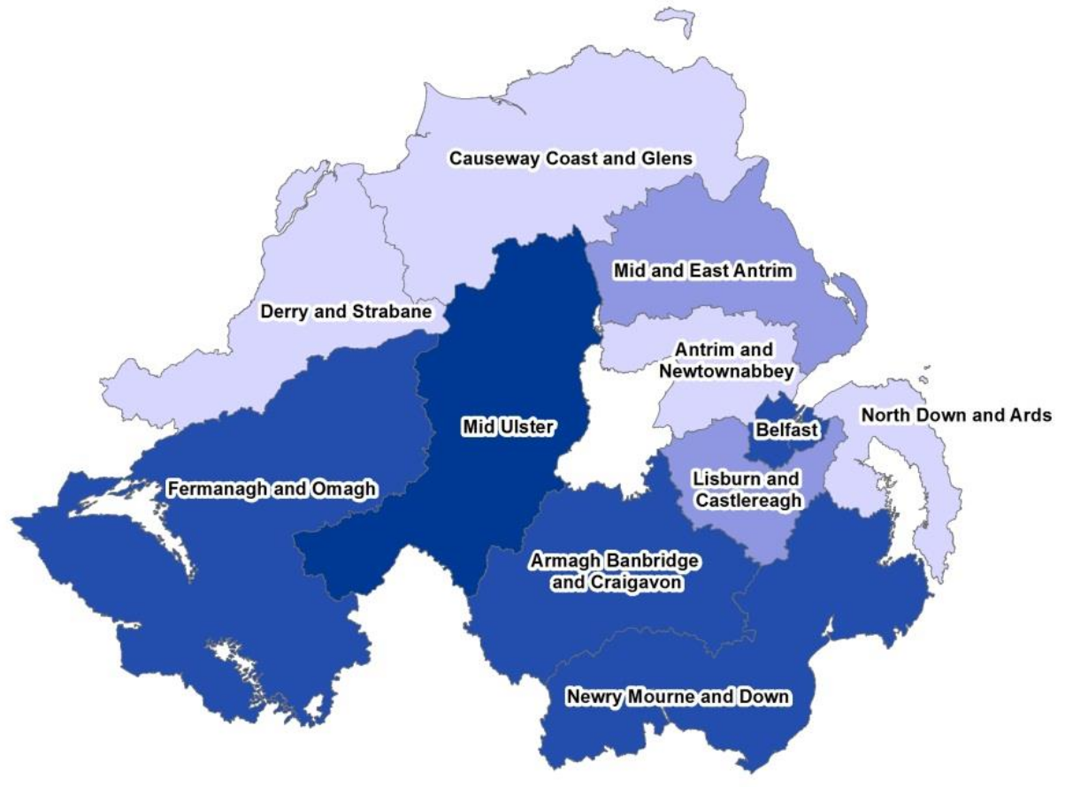
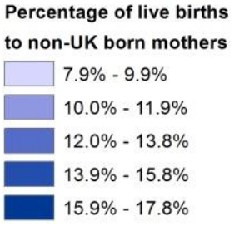
Geography of migrant inflows
Net international migration by district, 2006–2016
Births to non-UK mothers by district, 2006–2016

Slide 6
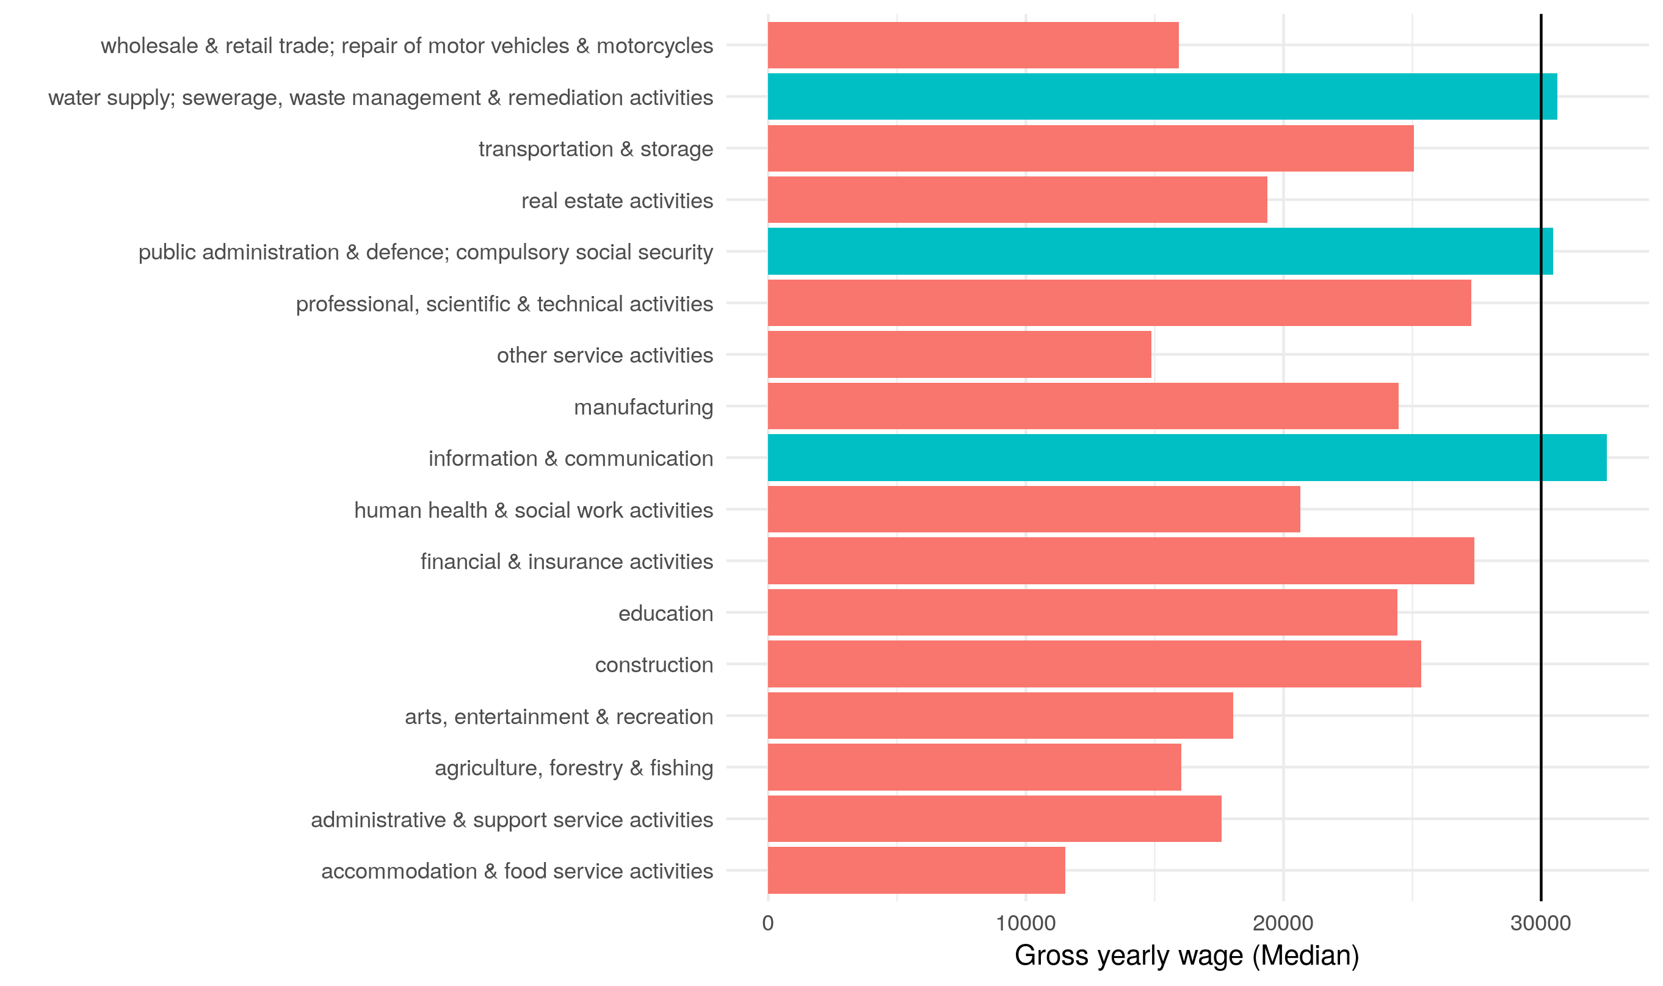
Threshold: Average industry wages in NI
The median (mean) wage in Northern Ireland is £22,016 (£25,704) compared to the UK’s £24,006 (£29,832).
Taking median wages, 83% of industries currently do not provide a salary equal to or above £30,000.
This is compared to 55% of industries, on average in the rest of the UK.

Slide 7
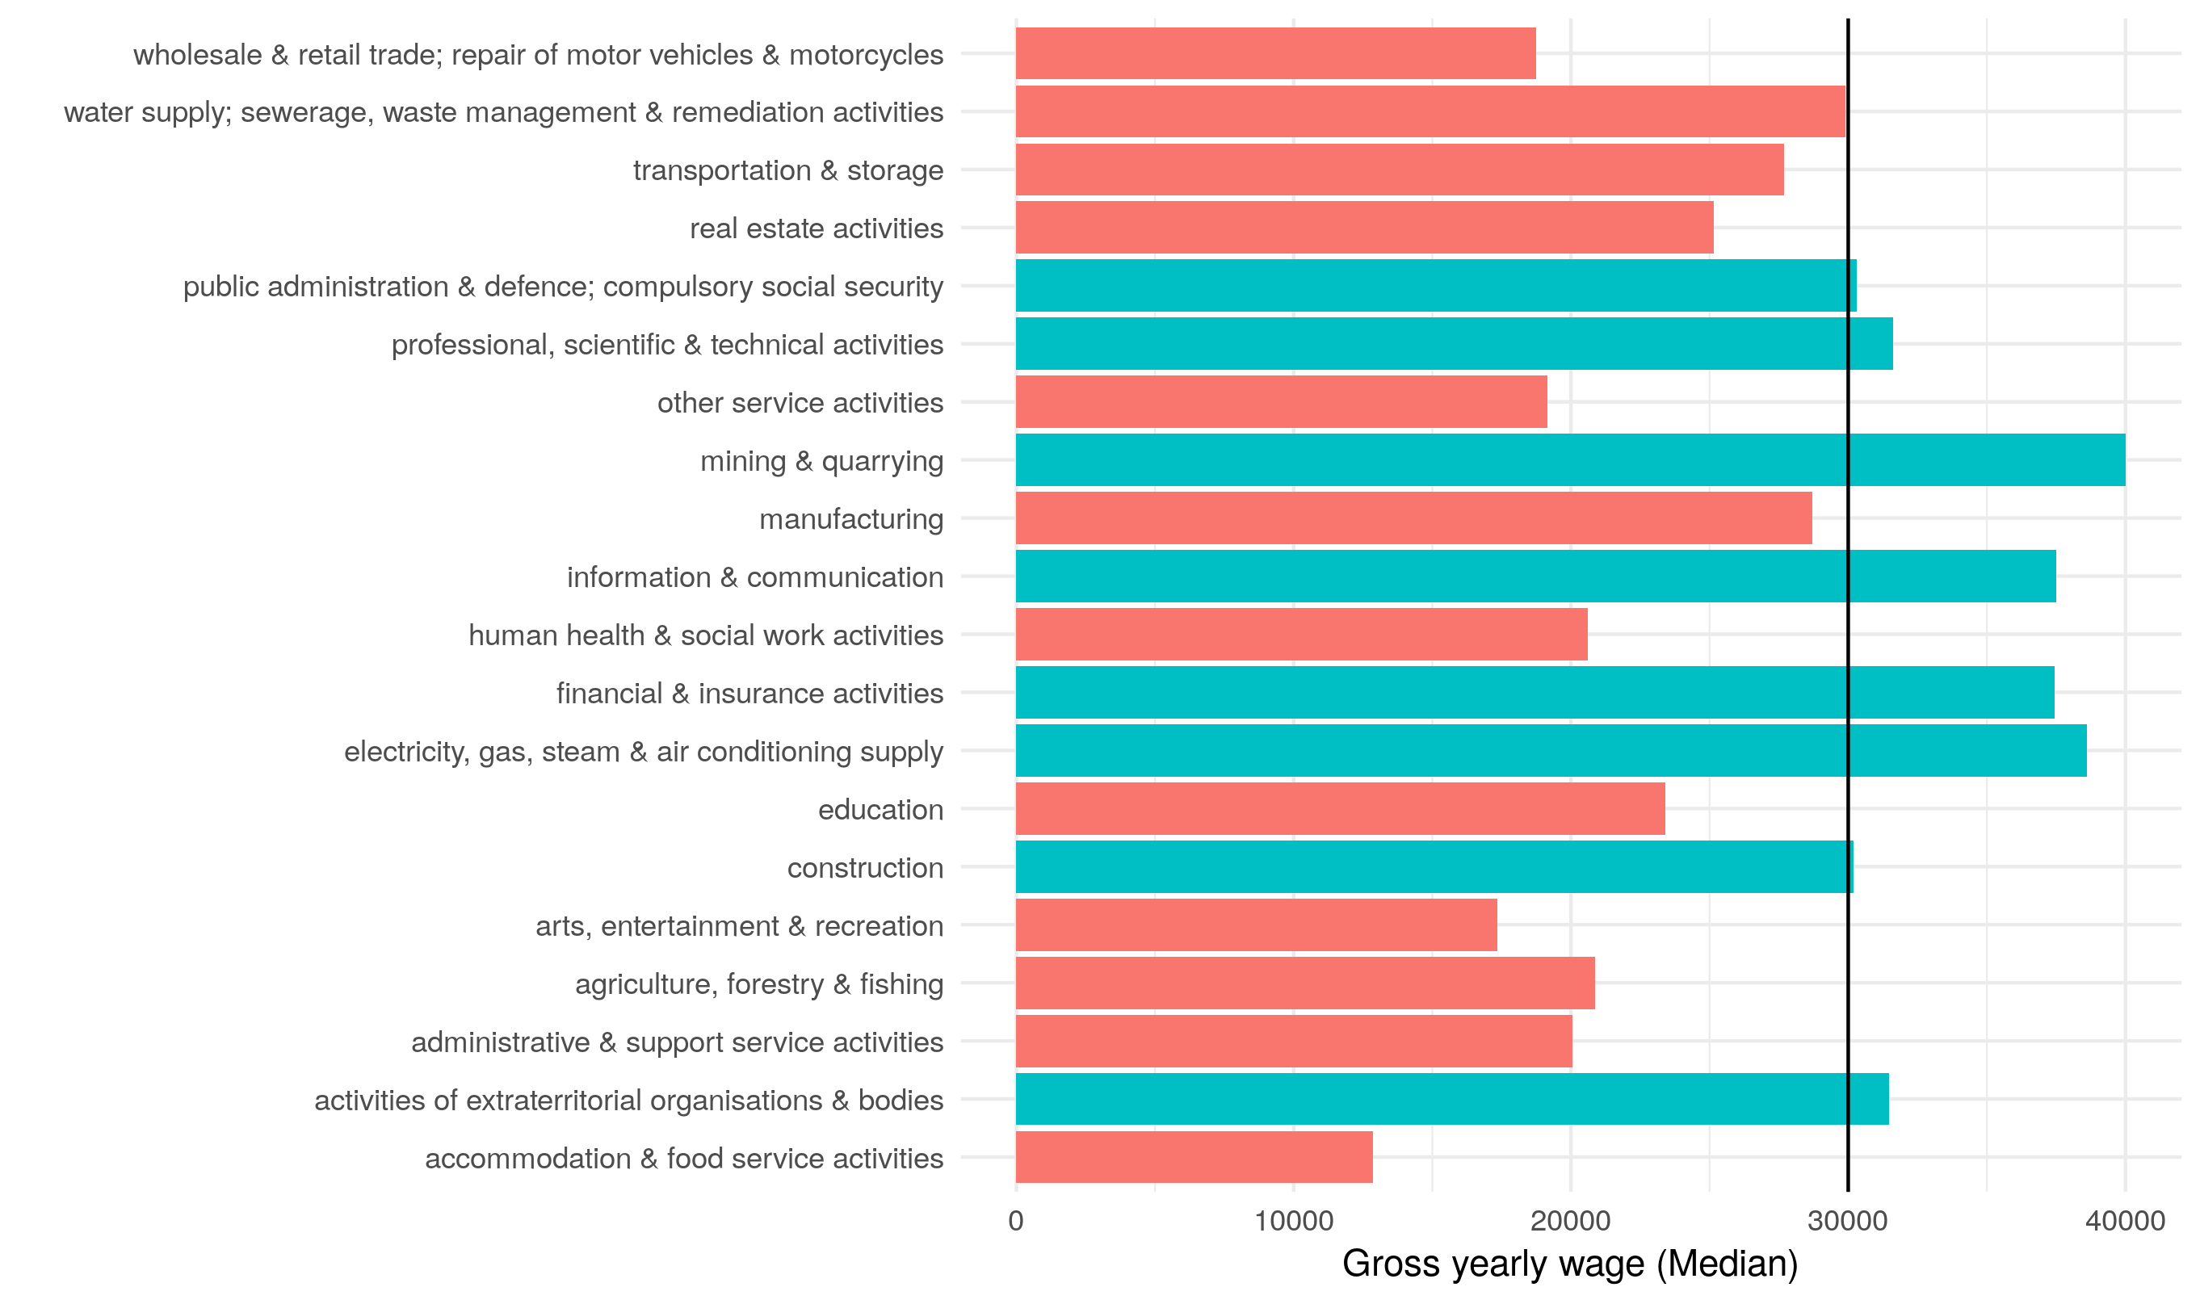
Threshold: Average industry wages in UK
The median (mean) wage in Northern Ireland is £22,016 (£25,704) compared to the UK’s £24,006 (£29,832).
Taking median wages, 83% of industries currently do not provide a salary equal to or above £30,000.
This is compared to 55% of industries, on average in the rest of the UK.

Slide 8
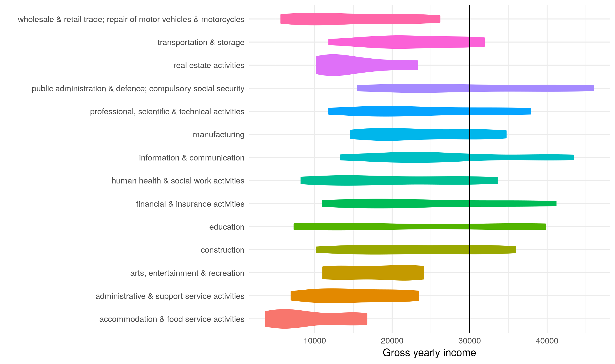
Threshold: Distribution of industry wages in ni
The distribution of wages in NI shows that:
Even at the top scale, 35% of industries would not be open to migrant workers even at the top end of the wage scale.
Other industries require workers to be in the upper 60%-70% to be open to migrant workers.
A lot of wage data is missing in Northern Ireland compared to the rest of the UK.
The public sector provides the most properous wages, even compared to growth sectors, such as Information & Communication.

Slide 9
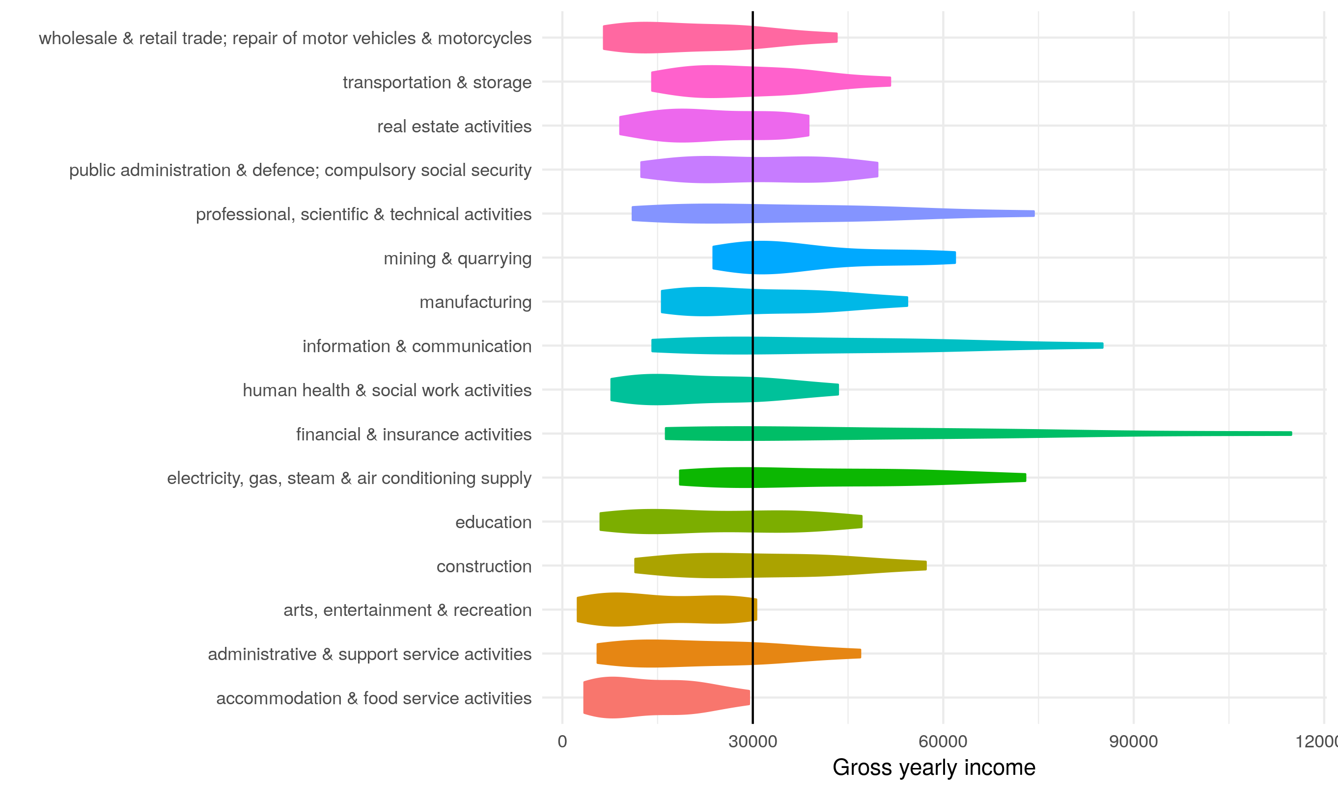
Threshold: Distribution of industry wages in UK
Significantly different to the UK average.
All industries can facilitate migrant labour at some level.
The composition of industry wages is remarkably different: financial & insurance activities, construction and manufacturing are more prosperous.
Importantly, public sector wages do not dominate other industries.

Slide 10
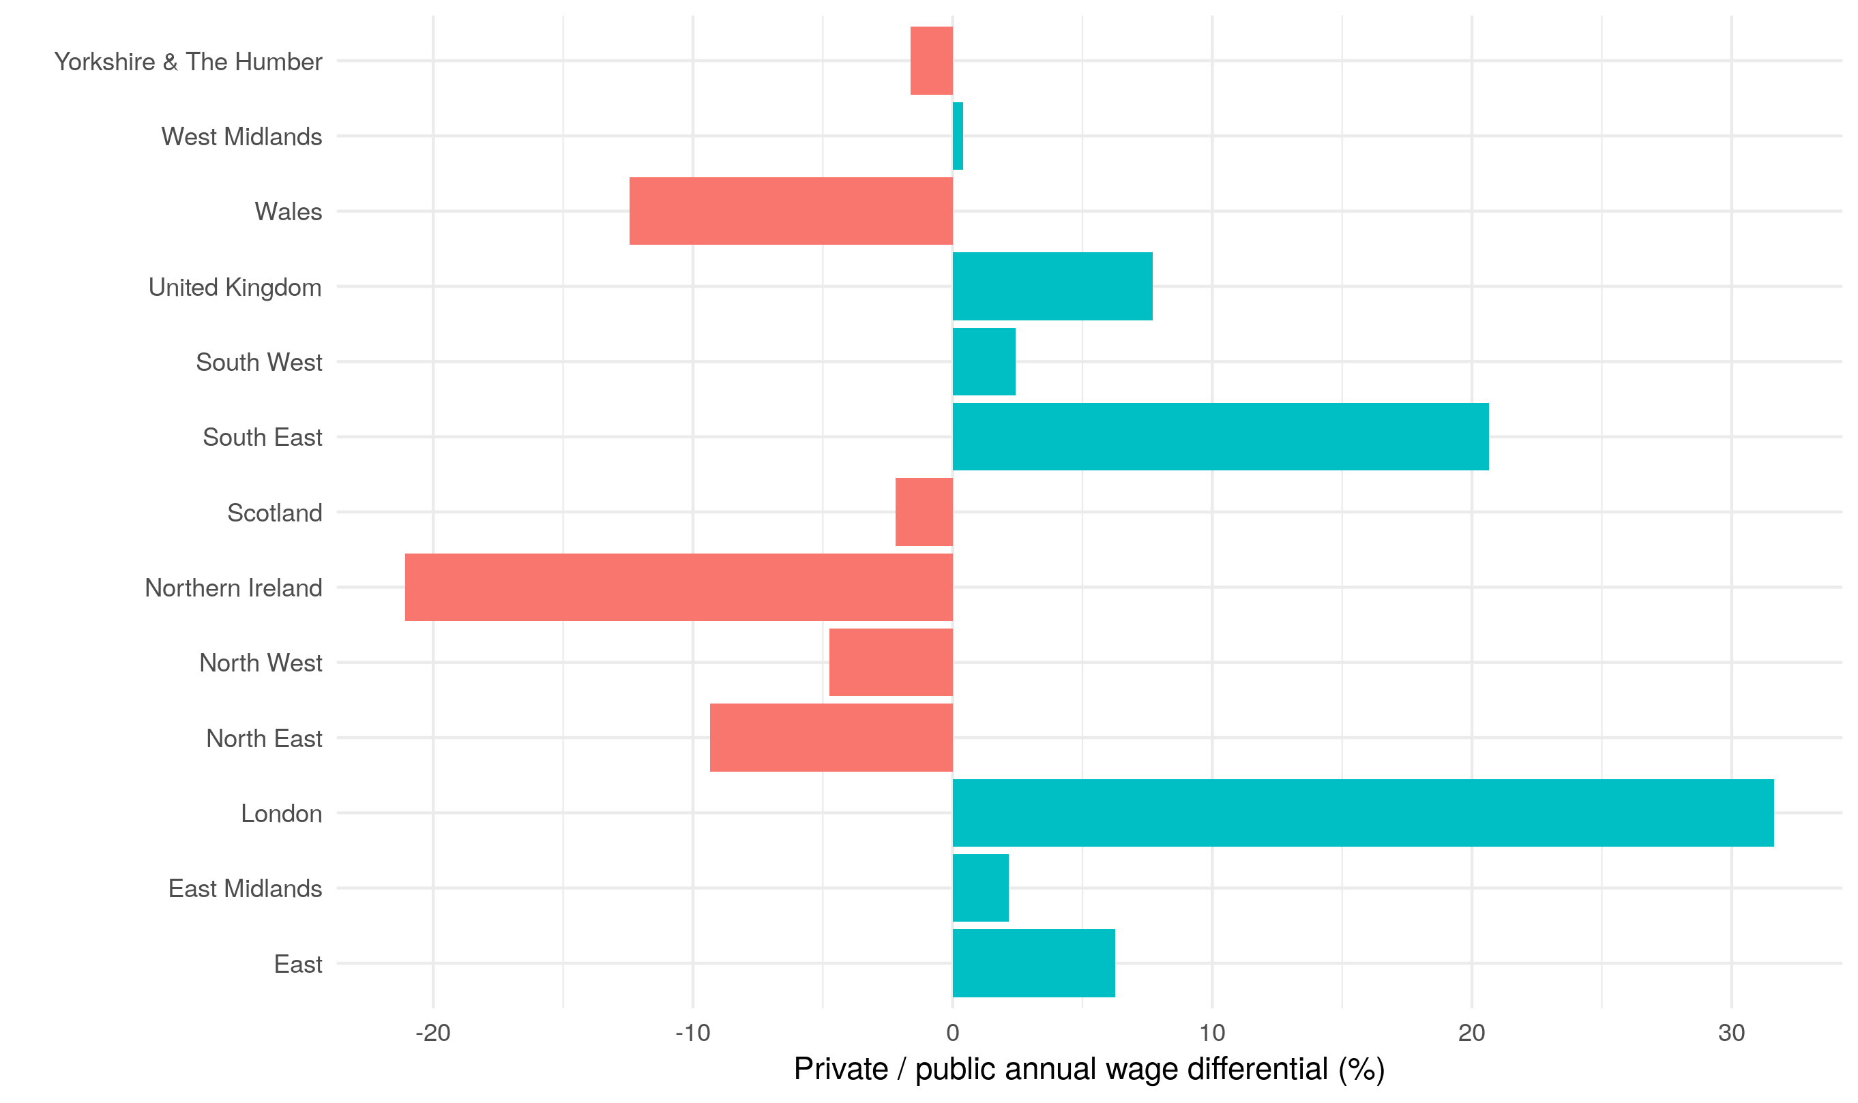
Threshold: Public / Private wage differential
Public sector wages distort the averages for NI compared to the rest of UK.
Average wages in the private sector are typically over 20% lower in NI compared to public sector wages. This is a real anomaly.
The median (mean) wage in NI private sector is £19,738 (£22,713) compared to the UK’s £23,628 (£30,779).

Slide 11
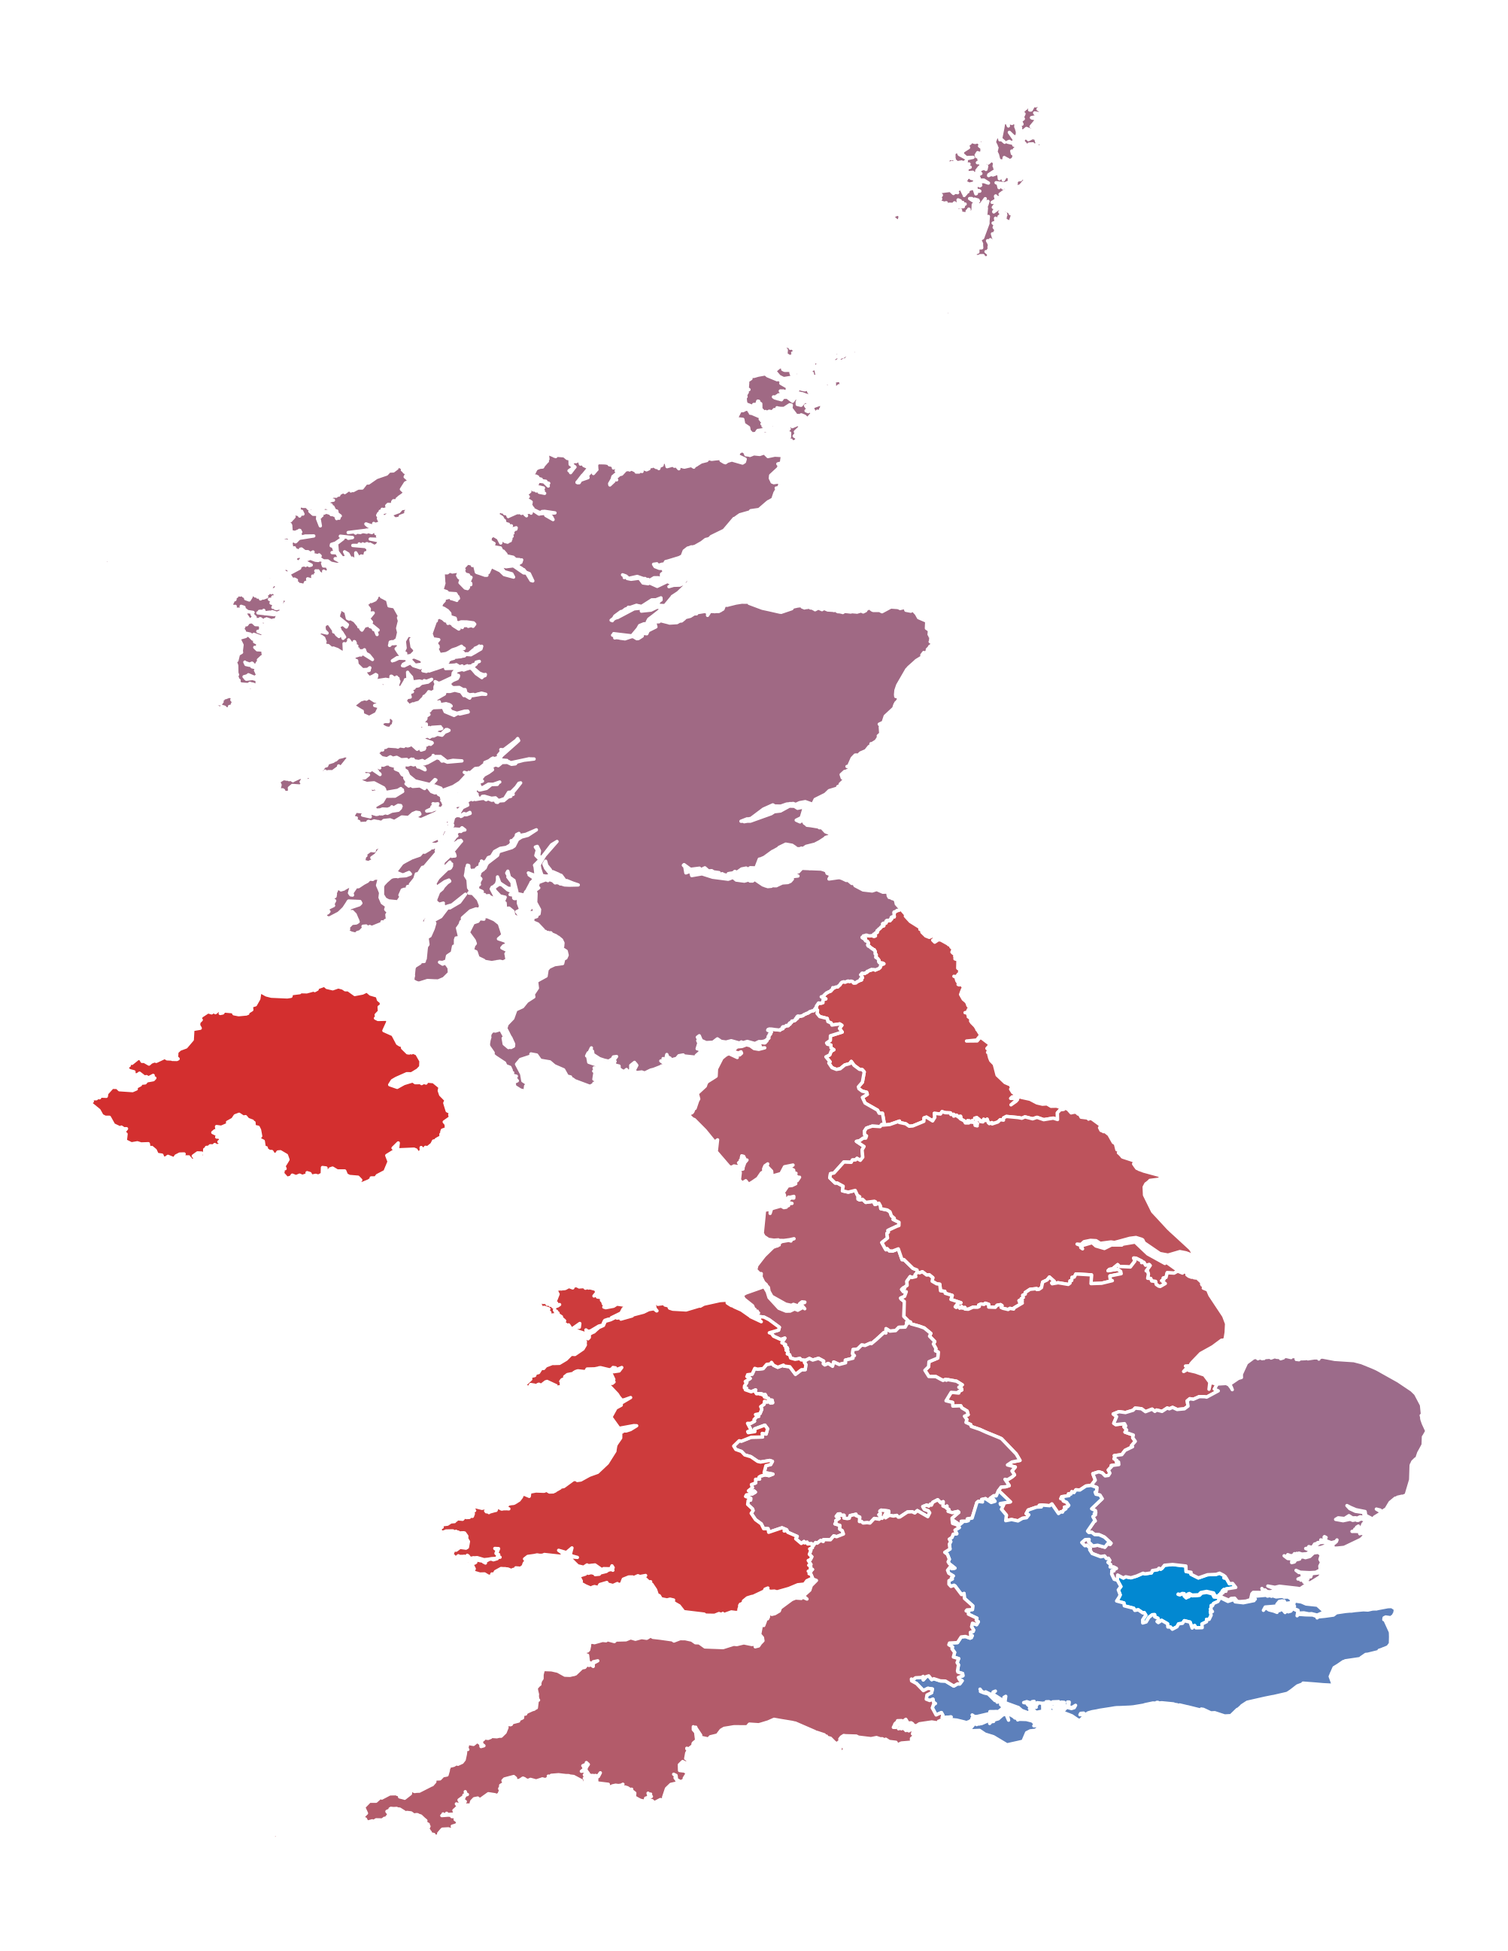
Impact of threshold throughout the UK
Using this public/private differential, combined with the mean wages from the throughout the UK we can mock up what regions will be impacted in the short-run.
Although NI seems to be impacted the most (particularly since industries impacted the most have the highest output and employment multipliers), it is not the only region.

Slide 12
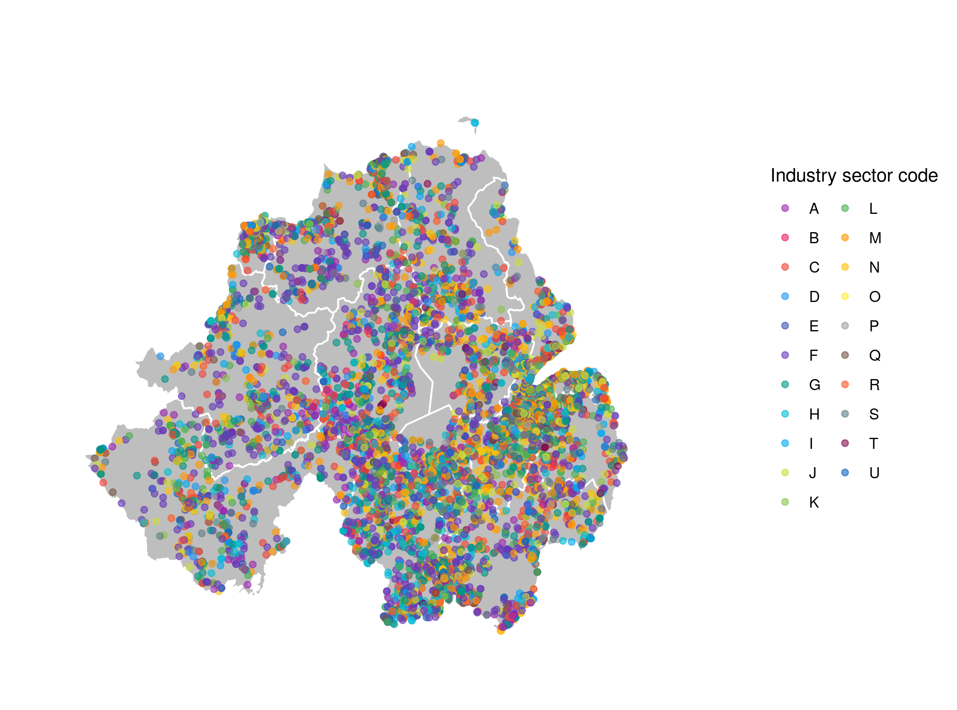
Most impacted areas in Northern Ireland (1)
Companies House have a very nice API, which can be used to request data on all firms operating in NI and across the UK.
Each company registers a 5 digit SIC code, which can be aggregated up to the industry sectors, like, Communication and Information.
Also able to extract balance sheet data (by parsing PDFs).

Slide 13
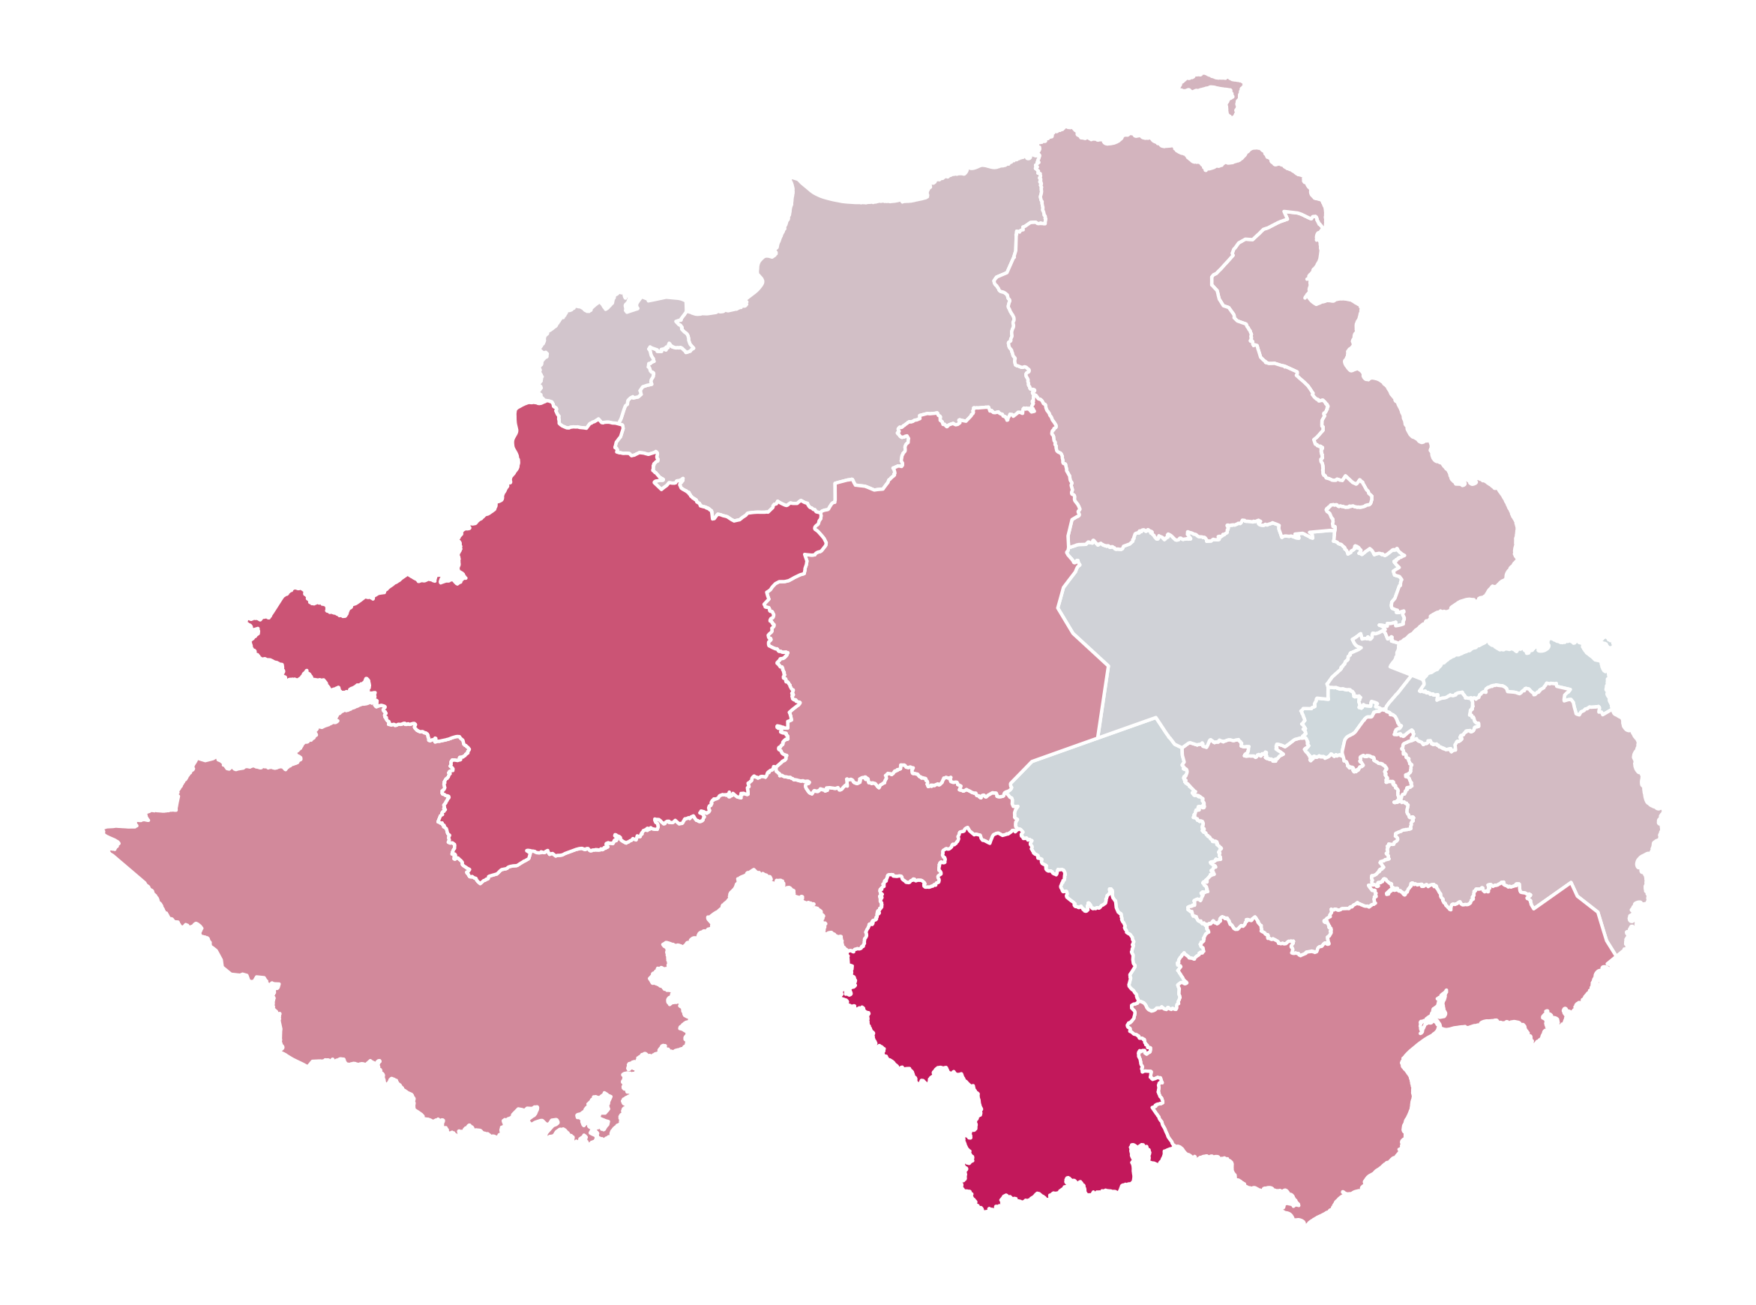
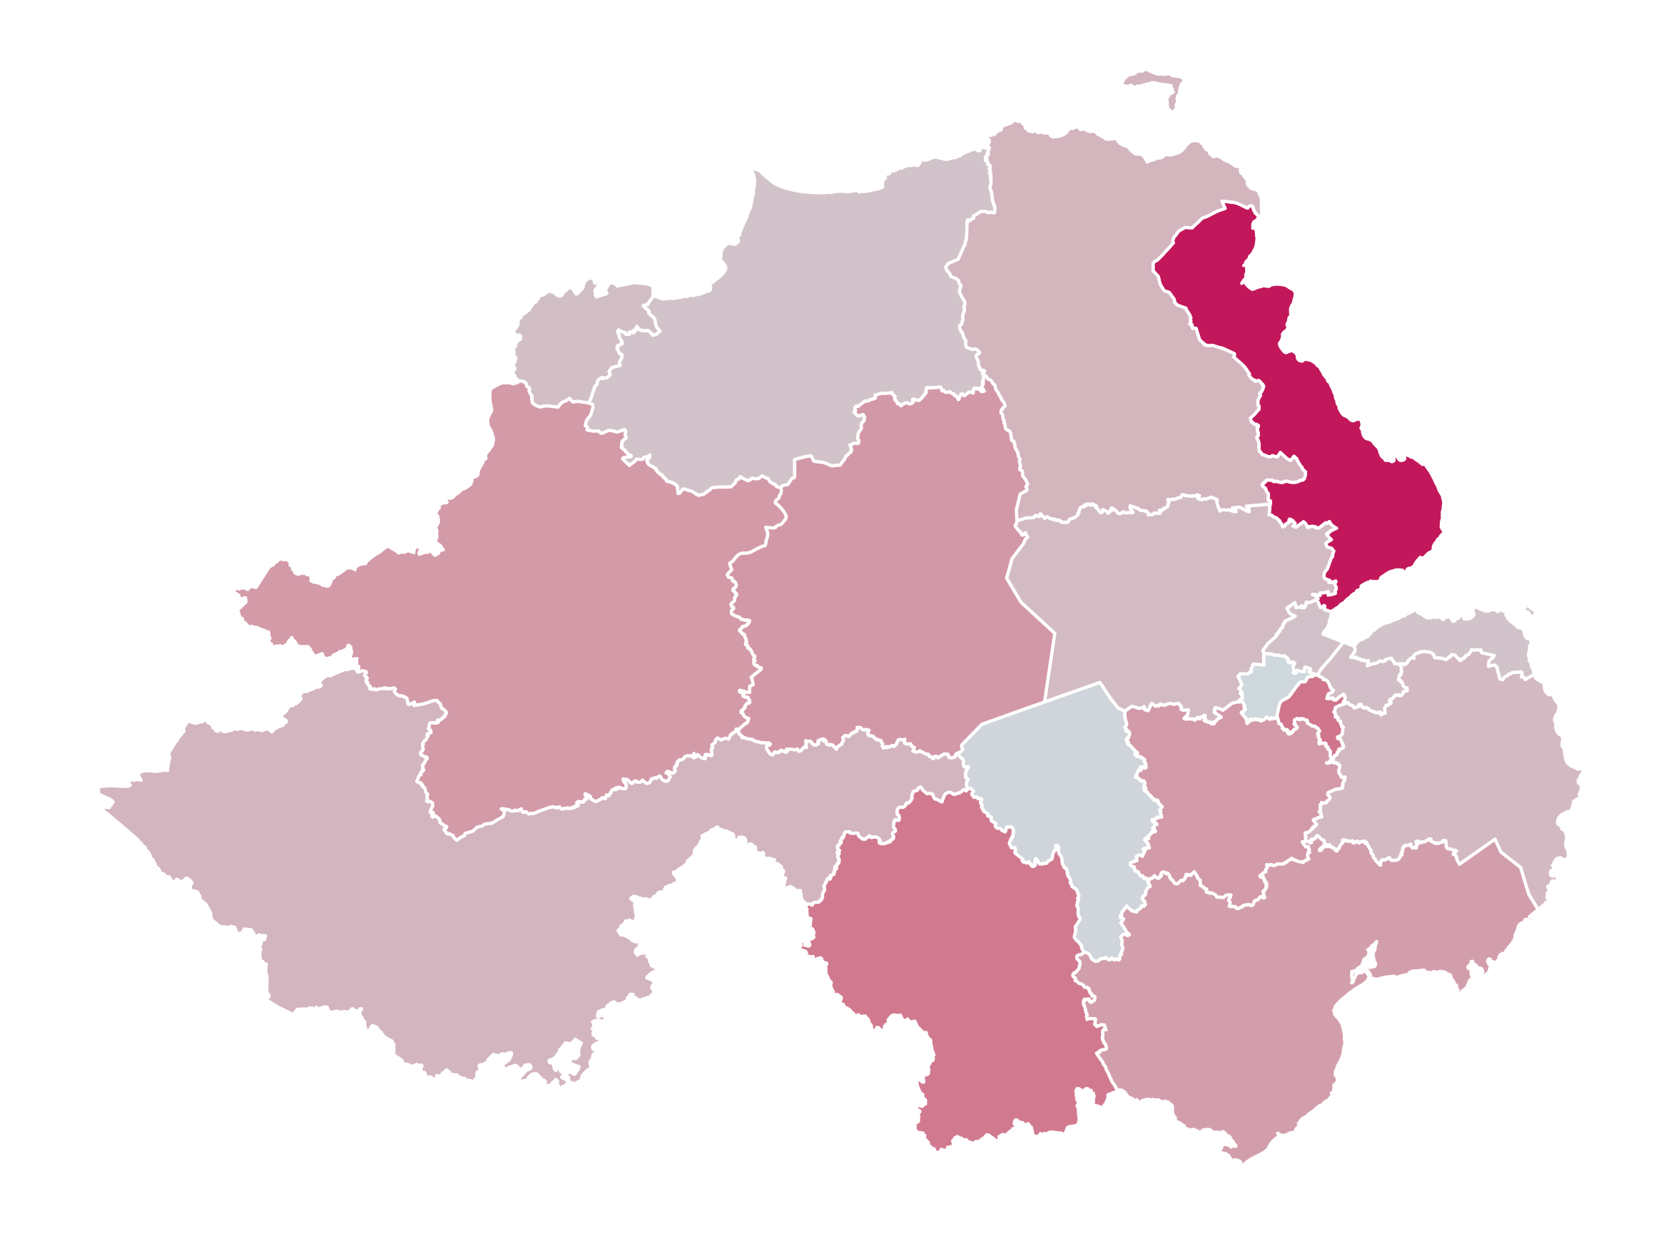
Most impacted areas in Northern Ireland (2)

